Slide 1
Chapter 5 Neural Networks

Slide 2
Contents
5.1 Feed-forward Network Functions
5.2 Network Training
5.3 Error Backpropagation
5.4 The Hessian Matrix
5.5 Regularization in Neural Networks
5.6 Mixture Density Networks
5.7 Bayesian Neural Networks

Slide 3
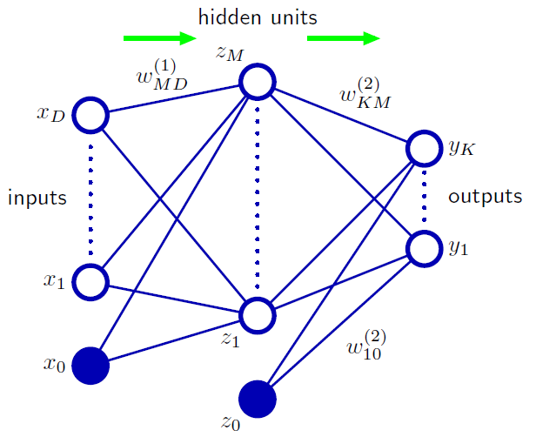





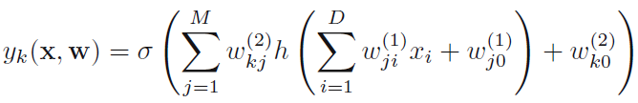
5.1 Feed-forward Network Functions
activations
activation function
Output unit activations
for standard regression problems
for multiple binary classification problems

Slide 4











5.2 Network Training
Training set:
minimize the error function
Regression problems of neural network in a probabilistic interpretation
Binary classification
$K$ separate binary classifications
1-of-K multiclass classification

Slide 5
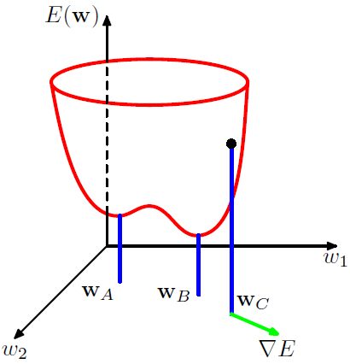







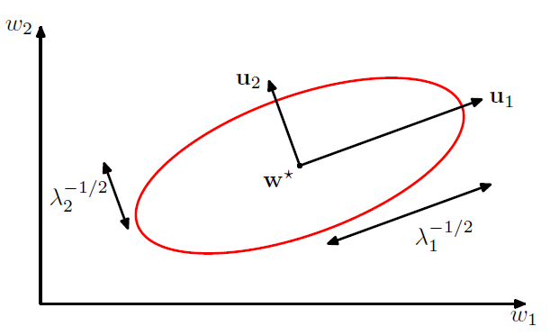




5.2 Network Training
Parameter optimization
Local quadratic approximation
Consider the Taylor expansion of $E(w)$around some point $\hat{w}$ in weight space
Local approximation to the gradient
Notes:
In order to understand the importance of gradient information, it is useful to consider a local approximation to the error function based on a Taylor expansion.

Slide 6


5.2 Network Training
Gradient descent optimization
gradient descent
sequential gradient descent
handle redundancy in the data much more efficiently than batch methods.
The possibility of escaping from local minima

Slide 7








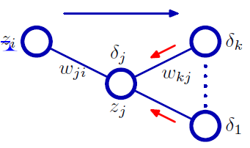


5.3 Error Backpropagation
Evaluation of error-function derivatives
for the output units
backpropagation formula
Notes:
Our goal in this section is to find an efficient technique for evaluating the gradient of an error function E(w) for a feed-forward neural network.

Slide 8
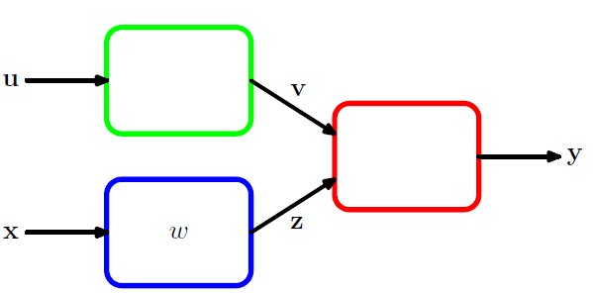



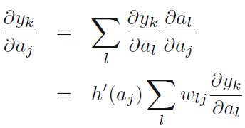
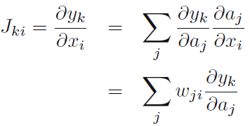
5.3 Error Backpropagation
The Jacobian matrix
Notes:
We have seen how the derivatives of an error function with respect to the weights can be obtained by the propagation of errors backwards through the network. The technique of backpropagation can also be applied to the calculation of other derivatives. Here we consider the evaluation of the Jacobian matrix, whose elements are given by the derivatives of the network outputs with respect to the inputs.

Slide 9

5.4 Hessian Matrix
Backpropagation can also be used to evaluate the second derivatives of the error, given by
The Hessian can also be calculated exactly using an extension of the backpropagation technique.
The Hessian plays an important role in many aspects of neural computing, including the following:
Several nonlinear optimization algorithms used for training neural networks are based on considerations of the second-order properties of the error surface, which are controlled by the Hessian matrix;
The Hessian forms the basis of a fast procedure for re-training a feed-forward network following a small change in the training data;
The inverse of the Hessian has been used to identify the least significant weights in a network as part of network ‘pruning’ algorithms;
The Hessian plays a central role in the Laplace approximation for a Bayesian neural network (see Section 5.7). Its inverse is used to determine the predictive distribution for a trained network, its eigenvalues determine the values of hyperparameters, and its determinant is used to evaluate the model evidence.

Slide 10




5.4 Hessian Matrix
Diagonal approximation
Some of the applications for the Hessian matrix discussed above require the inverse of the Hessian, rather than the Hessian itself. For this reason, there has been some interest in using a diagonal approximation to the Hessian, in other words one that simply replaces the off-diagonal elements with zeros, because its inverse is trivial to evaluate.
neglect off-diagonal elements in the second-derivative terms

Slide 11






5.4 Hessian Matrix
Outer product approximation
When neural networks are applied to regression problems, it is common to use a sum-of-squares error function of the form.
By neglecting the second term, we arrive at the Levenberg–Marquardt approximation or outer product approximation.
In the case of the cross-entropy error function for a network with logistic sigmoid output-unit activation functions, the corresponding approximation is given by

Slide 12




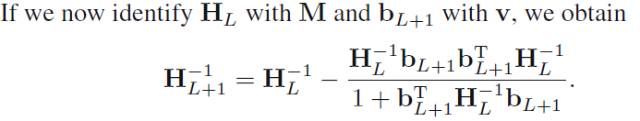
5.4 Hessian Matrix
Inverse Hessian
We can use the outer-product approximation to develop a computationally efficient procedure for approximating the inverse of the Hessian. First we write the outer-product approximation in matrix notation as
In order to evaluate the inverse of the Hessian, we now consider the matrix identity, which is simply a special case of the Woodbury identity.

Slide 13
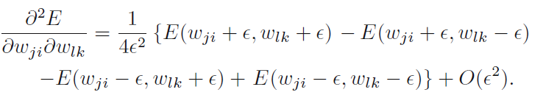

5.4 Hessian Matrix
Finite differences
This require $O(W^{3})$operations to evaluate the complete Hessian
Apply central differences to the first derivatives of the error function
This require $O(W^{2})$operations to evaluate the complete Hessian

Slide 14


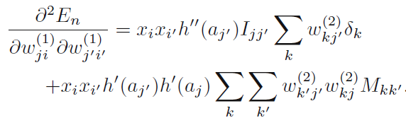


5.4 Hessian Matrix
Exact evaluation of the Hessian
The Hessian can also be evaluated exactly, for a network of arbitrary feed-forward topology, using extension of the technique of backpropagation used to evaluate first derivatives, which shares many of its desirable features including computational efficiency.
Here we consider the specific case of a network having two layers of weights, for which the required equations are easily derived.
1. Both weights in the second layer:
2. Both weights in the first layer:
3. One weight in each layer:
Notes:
We shall use indices i and i to denote inputs, indices j and j to denoted hidden units, and indices k and k to denote outputs. We first define En is the contribution to the error from data point n.

Slide 15

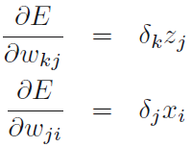
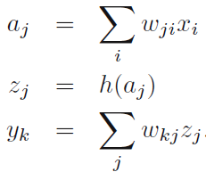
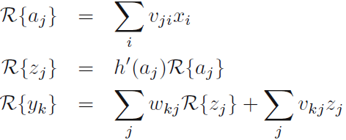
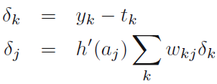
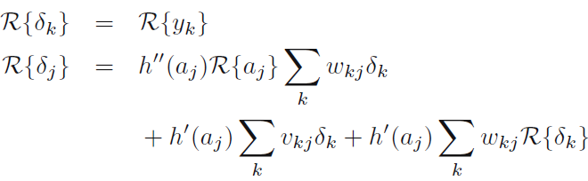
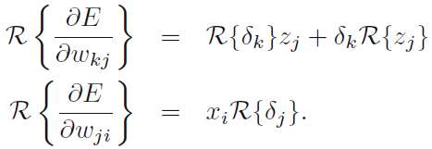
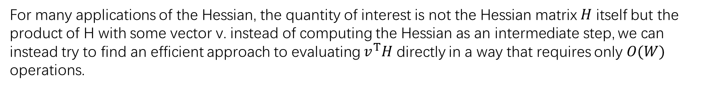
5.4 Hessian Matrix
Fast multiplication by the Hessian
For many applications of the Hessian, the quantity of interest is not the Hessian matrix $H$ itself but the product of H with some vector v. instead of computing the Hessian as an intermediate step, we can instead try to find an efficient approach to evaluating $v^{T}H$ directly in a way that requires only $O(W)$ operations.
use the notation $R\{·\}$to denote the operator $v^{T}∇,then$

Slide 16

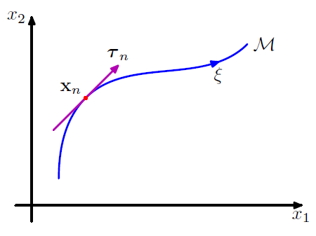

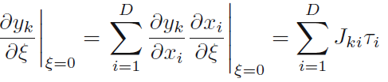

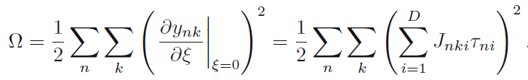
5.5 Regularization in Neural Networks
Tangent propagation
We can use regularization to encourage models to be invariant to transformations of the input through the technique of tangent propagation.
Notes:
The regularization function will be zero when the network mapping function is invariant under the transformation in the neighborhood of each pattern vector, and the value of the parameter λ determines the balance between fitting the training data and learning the invariance property.

Slide 17


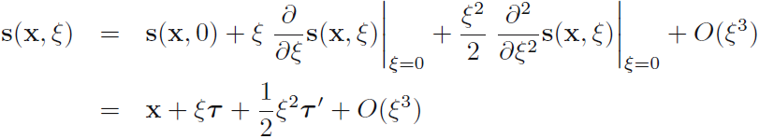


5.5 Regularization in Neural Networks
Training with transformed data
One way to encourage invariance of a model to a set of transformations is to expand the training set using transformed versions of the original input patterns.
Consider a transformation governed by a single parameter ξ and described by the function $s(x, ξ)$, with $s(x, 0) = x$.
sum-of-squares error
If we now consider an infinite number of copies of each data point, each of which is perturbed by the transformation in which the parameter $ξ$ is drawn from a distribution $p(ξ),$then
Expand the transformation function as a Taylor series in powers of $ξ$
Notes:
？check the book

Slide 18
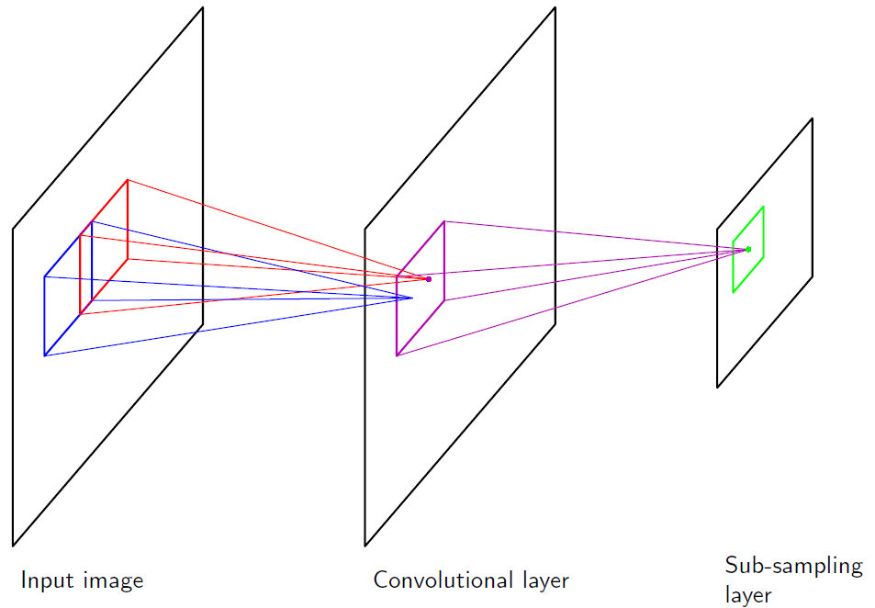
5.5 Regularization in Neural Networks
Convolutional networks
Another approach to creating models that are invariant to certain transformation of the inputs is to build the invariance properties into the structure of a neural network. This is the basis for the convolutional neural network.
local receptive fields,
weight sharing, and
subsampling.

Slide 19


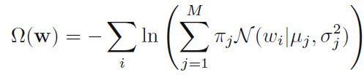





5.5 Regularization in Neural Networks
Soft weight sharing
Here we consider a form of soft weight sharing in which the hard constraint of equal weights is replaced by a form of regularization in which groups of weights are encouraged to have similar values.
Consider a mixture of Gaussians
Regard the $\left\{π_{j}\right\}$ as prior probabilities, then the posterior
The derivatives of the total error function with respect to

Slide 20

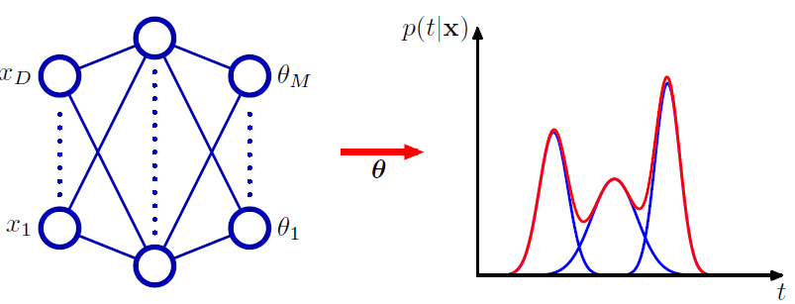
5.6 Mixture Density Networks
Mixing coefficients $π_{k}(x)$, the means $μ_{k}(x)$, and the variances $σ_{k}^{2} (x)$, to be governed by the outputs of a conventional neural network.

Slide 21





5.7 Bayesian Neural Networks
Posterior parameter distribution
conditional distribution
prior
likelihood
posterior
find a Gaussian approximation to the posterior distribution by using the Laplace approximation.
predictive distribution
Notes:
In a Bayesian treatment of neural networks, to get the predictive function, we need to marginalize over the distribution of the parameters.

Slide 22








5.7 Bayesian Neural Networks
Bayesian neural networks for classification
The log likelihood function for this model is given by
maximize the marginal likelihood
linear approximation of output activation

